Slide 1

Restaurant Management System
---

Slide 2
Slide:1
• Project Title : Restaurant Management System​
• Name : VIGNESH . S​
• Date Submitted : 15\10\2024

Slide 3
Slide:2
Aim of the Project Content:
• Efficient Order Management:
To enable seamless management of orders, ensuring accurate tracking
and processing.
• Calculate a orders and income of the restaurant
• Allows customers to access a summary of all their placed orders,
showing quantities and total amounts for easy tracking

Slide 4
Slide:3
Business Problem or Problem Statement:
Menu Management:
Restaurants need an organized way to present their menu items, including prices and categories (Veg or Non-Veg).
Efficiency:
Manual order taking and record-keeping can slow down service.
Order Tracking:
Keeping track of multiple orders can be challenging.
A poor ordering experience can lead to customer dissatisfaction and reduced repeat business.

Slide 5
Slide:4
Project Description:
operations, focusing on menu management and order processing.
The primary users of the system include restaurant staff and customers.
The project aims to automate the ordering process, provide a clear menu structure, and maintain an order summary for better tracking.
Objectives :
Menu Management , Order Processing , Order Tracking , User-Friendly Interface , Error Handling
Technologies and Methodologies Used :
Programming Language:
Python:
Object-Oriented Programming (OOP): Error Handling:

Slide 6
Slide:5
Functionalities :
Add Menu Item:
Allows the restaurant to add new items to the menu with details like name, price, and category (Veg or Non-Veg).
Show Menu:
Displays the complete list of menu items, including their names, categories, and prices.
Place Order:
Enables customers to place an order for a specific item from the menu, specifying the quantity. It calculates and displays the total price for the order.
View Orders:
Provides a summary of all orders placed, detailing the items ordered,
their quantities, and total prices.
Exit:
Ends the program and displays a final summary of the orders placed before exiting.

Slide 7
Slide:6
Methods in the Restaurant Class :
__init__: Initializes a new restaurant instance, creating empty lists for the menu and orders.
add_menu_item(item): Adds a new MenuItem object to the restaurant's menu.
show_menu(): Prints the current menu, listing all menu items with their details.
place_order(item_name, quantity): Accepts an item name and quantity, checks if the item exists in the menu, calculates the total price, and adds the order to the list of orders.
view_orders(): Displays a summary of all orders placed, including the item names, quantities, and total prices.
Functions in the main()
main(): The main function that runs the restaurant management system. It includes:
Adding initial menu items.
A loop that presents a menu to the user for showing the menu, placing orders, viewing orders, or exiting the program.

Slide 8
Slide:7
Input Versatility with Error Handling and Exception Handling :
Input Versatility:
1.Item Name Input:
The program allows users to enter the name of the menu item in any case (e.g., "sambar rice", "Sambar Rice") due to the use of lower() for case-insensitive comparison.
2.Quantity Input:
the user can specify the quantity of the item they wish to order, allowing flexibility in ordering (e.g., "1", "2", "5").
Error and Exception Handling :
1.Invalid Quantity Input:
2.Negative or Zero Quantity:
3.Item Not Found:
3.Handling Invalid Menu Choices:

Slide 9
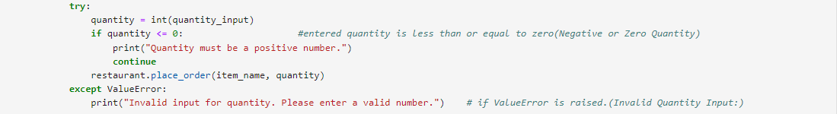
Slide:8

Slide 10
code implementation:
Diagram -
Create a Restaurant instance
Add menu items
1.Start
2.Initialize Restaurant
Display Menu Options:
Show Menu
Place Order
View Orders
Exit
3.User Interaction Loop
4.Handle User Choice
Show Menu: Call show_menu()
Place Order:
Input item name
Input quantity
Call place_order()
View Orders: Call view_orders()
Exit: Call view_orders() and exit
5.End

Slide 11
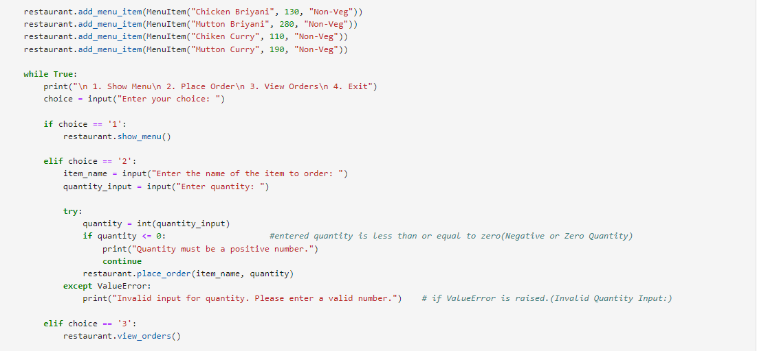
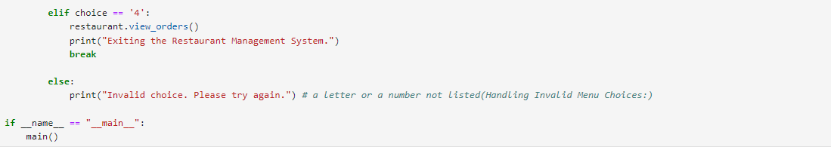

Slide 12
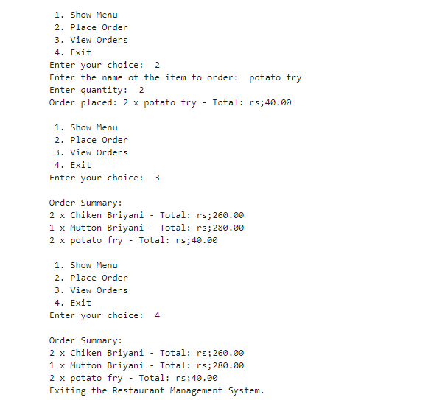
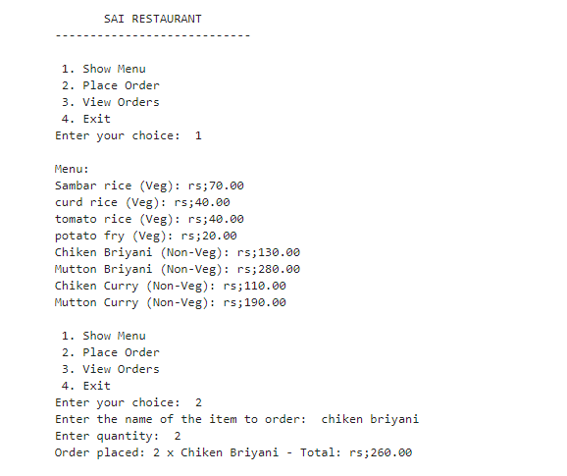
Results and Outcomes:

Slide 13
Conclusion:
Enhanced Order Accuracy: Reduced errors in order processing, leading to improved customer satisfaction.
Increased Efficiency: Streamlined the ordering process, significantly decreasing the time taken to serve customers.
Valuable Insights: Collected data on menu popularity and peak order times, enabling better inventory management and staffing.
Future Developments;
Integration of Online Ordering: Expanding the system to allow customers to place orders via a web or mobile application.​
Payment Processing Features: Implementing secure payment gateways to facilitate smooth transactions.​
Customer Feedback Mechanism: Introducing features for customers to provide feedback directly through the system, further enhancing service quality.

Slide 14


